Slide 1
I Shall Not Want
Psalm 23  John 10
Notes:
Jesus came as the Good Shepherd to fully provide for the needs of His sheep – to fill us and fulfill us. His provisions are so complete that we long for nothing else and can accomplish all that He would have us do.

Slide 2
Jesus came to fill us and fulfill us
We are completely filled in Him (Colossians 2:9-10).
We have no desire for more (John 6:35).
Greed, fleshly lust, covetousness, and worldly desires HAVE NO SPACE in the life of one whose “cup runs over” (Ephesians 5:3; Hebrews 13:5; 1 Timothy 6:5-8).

Slide 3
We are filled with God’s Power
We can do all things through Him (Philippians 4:12-13).
His power works in us. (Ephesians 3:18-20)
In Him we are complete for every good work (Hebrews 13:20-21; 2 Corinthians 9:8; Romans 8:32-39).

Slide 4
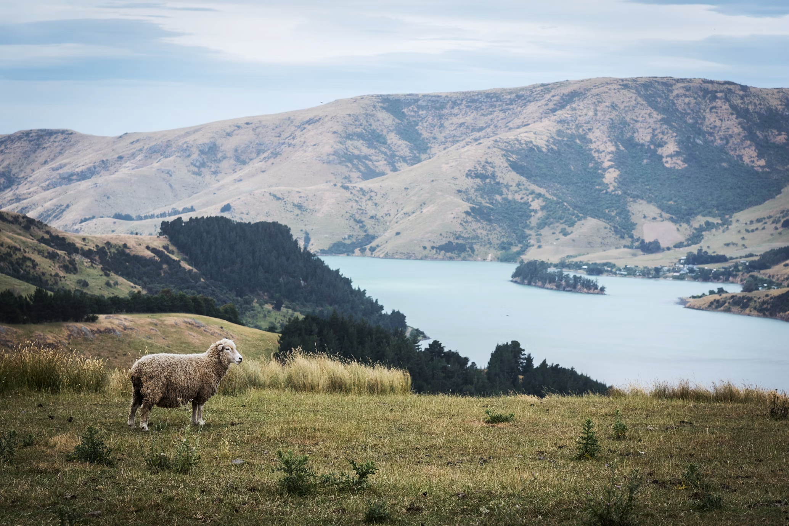
“All I have needed Thy hand hath provided.
Great is Thy faithfulness, Lord, unto me!

